Slide 1


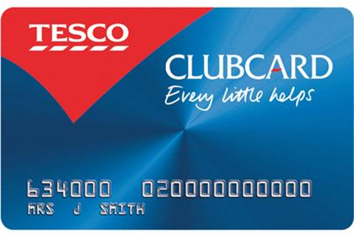
Next Generation Clubcard
NGC
Guruprasad Bhandary

Slide 2
Contents
Description
Business Objective
An overview
High Level Functionality
NGC Marketing
Management of System
Architecture
The technical environment
Integration with other system
Application link and user details
Appendix

Slide 3
Description
In order to gain the loyalty of the customers TESCO had launched Clubcard in the year 1994.
All the Clubcard holders are sent coupons based on their shopping habits, life stage, life style, geographic location.
Coupons are thus highly targeted based on the above mentioned range of attributes.
TEPLOG is the file generated by the stores which has the record of everything that the customer is buying and this file is ultimately sent to DHA(Dunn Humby Associates) for analysis of customer buying habits. Based on this, coupons are sent to customers.
There are various types of coupons which satisfy the objectives of the Clubcard.
Some examples of coupons are bonus coupons, price promise coupons

Slide 4
Business Objective
NGC is a loyalty solution. The purpose of a loyalty solution is to encourage customer affinity with a brand.
Loyalty is encouraged by offering periodic incentives to customers in club card which are proportional to the amount of spend.
NGC, as an example of a loyalty scheme – specifically related to the Tesco brand, operates by offering a cash equivalent reward as a direct conversion of the amount of spend by a customer.

Slide 5
An Overview
What is NGC?
  It is a group application for managing our loyalty card program
Who develops NGC?
  Developments are decided by Tesco Group. These are made to support the evolution of the Clubcard scheme according to the “Clubcard Roadmap”
  NGC was designed and developed by Tesco HSC in India
Why should we use NGC?
  NGC is a group application and part of Operating Model deployment plan
Who uses NGC?
  Marketing, Clubcard Helpline, Customer Service Desk, Tills

Slide 6
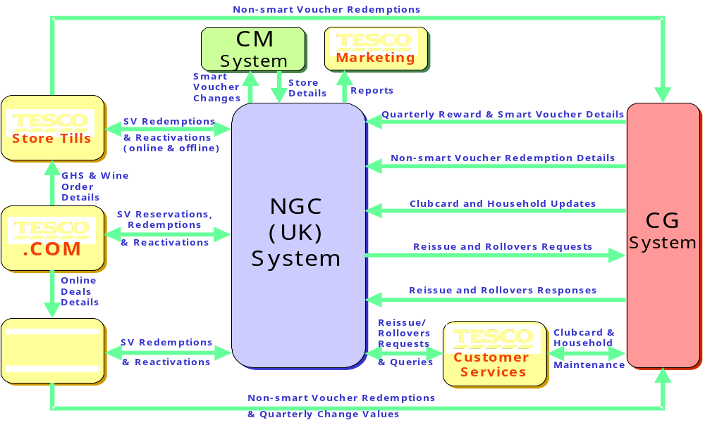
High Level Functionality

Slide 7
NGC Marketing: Overview
NGC Marketing module is used by Marketing for following activities:
  Add, Edit and Delete Collection Periods
  Administer CSD Limits for Adding/ Subtracting Reward Points
  Setup Coupons
  Setup Reward Vouchers
  Calculate Rewards
  Create Mailing Report
  Approve Mailing Report
  View Key Reports

Slide 8
Management of System for Data Processing
.Granting access to the system
  The software support console is the module of NGC which allows an administrator to setup users, roles and groups. This process is defined below.
  The user section deals with user management activities ,users are the NGC application users who are giving to use different modules/screens of NGC
  .Data security on first registration
  NGC enforces a stringent audit trail process to ensure tracking is available for new and updated information within the database. This enforcement covers both batch processes and front end user interface processes.

Slide 9
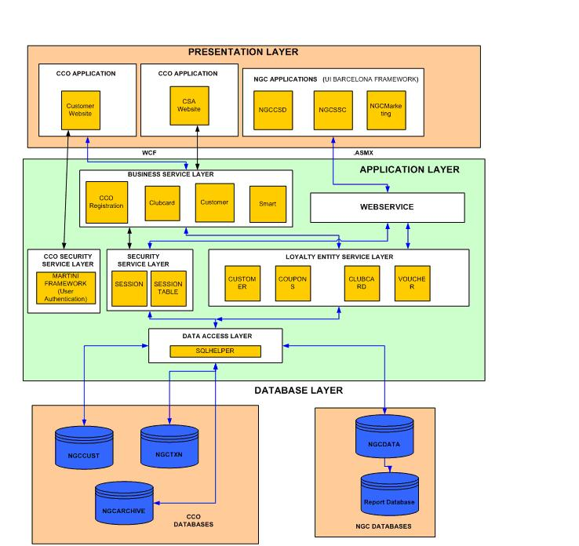
Architecture

Slide 10
NGC can be accessed through four modules:
Contd:
  Marketing
  CSD (Customer Service Desk)
  SSC (Software Support Console)
  MCA (My club card account)

Slide 11
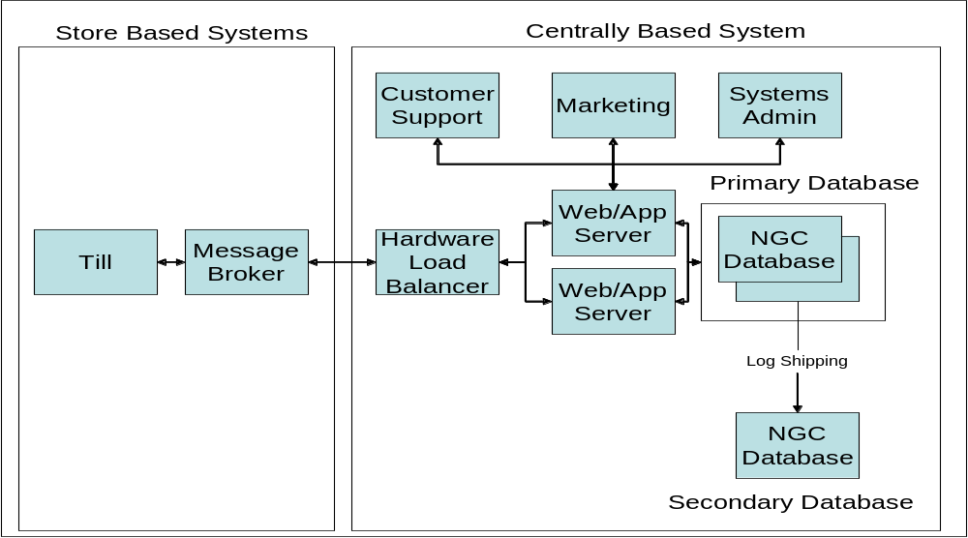
Contd:
The architectural composition of the NGC application
The main operational system is composed of the Store components
(Tills, Message Broker) and the Centre components (Hardware Load Balancers,
Multiple Web/App Servers and Clustered Database Servers.

Slide 12
Contd:
The business environment in which Clubcard operates
NGC Application Context
3
rd
Party
3
rd
Party
3
rd
Party
Mailing
Data Entry
Partner
CSD
House
D
A
Mailing
Payment
G
Service
Provider
J
HSC
Till
C
NGC
I
Finance
E
F
H
Systems
B
Transaction
H
’
Legacy
Repository
dunn
Systems
humby
GMIS

Slide 13
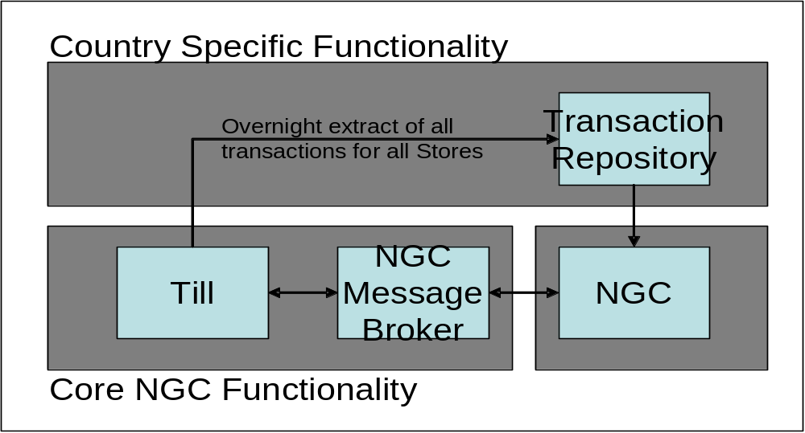
The technical environment
The system operates by the till making a request of NGC.
NGC responds to this query and provides balance information to the till.
The till then updates NGC with the points balance for that transaction.

Slide 14
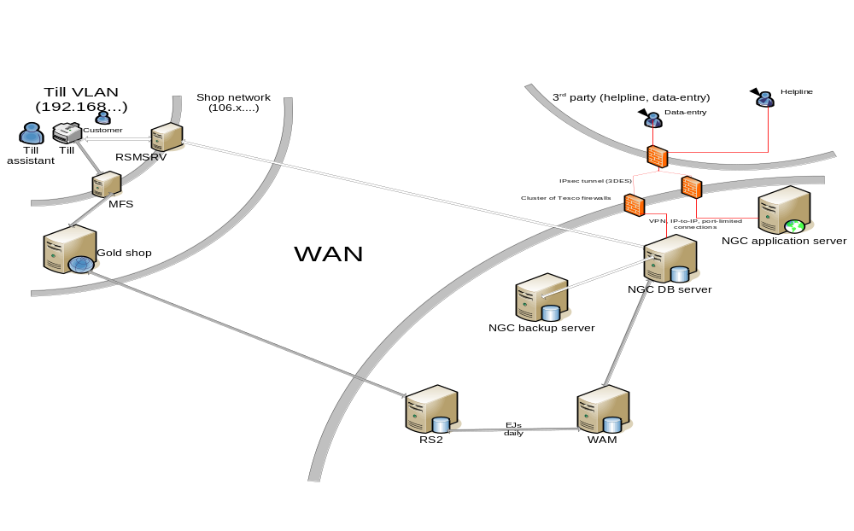
Contd:
System Security
The general components within the network are a private network between Stores and Centre operated as a wide area network (WAN). The Stores and Centre are all deployed within their own virtual local area network (VLAN) to increase the level of security.

Slide 15
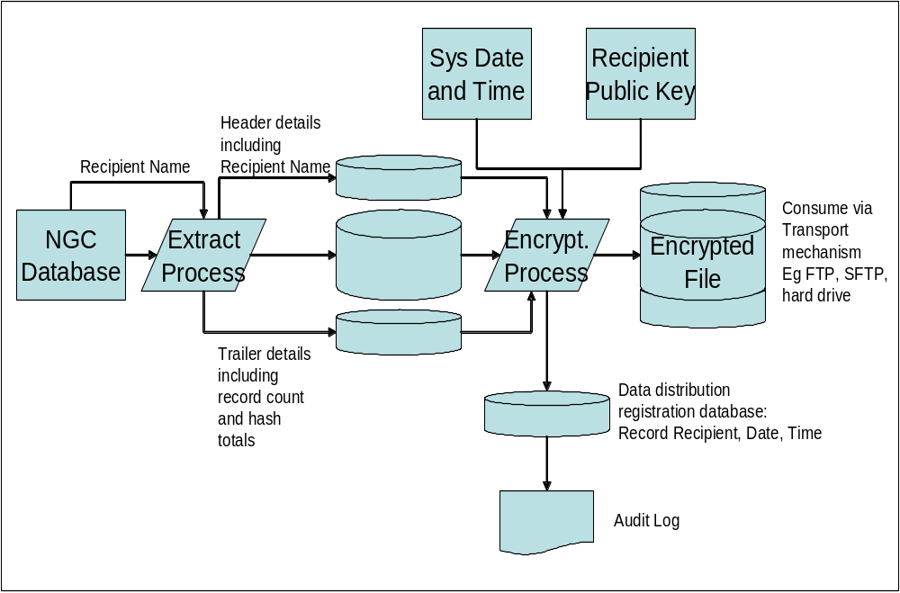
Contd:
  Data Retention Policy
Tesco uses an internal business service to encrypt data for transmission.
This service isn’t owned by any one application but is a shared resource
amongst all applications.

Slide 16
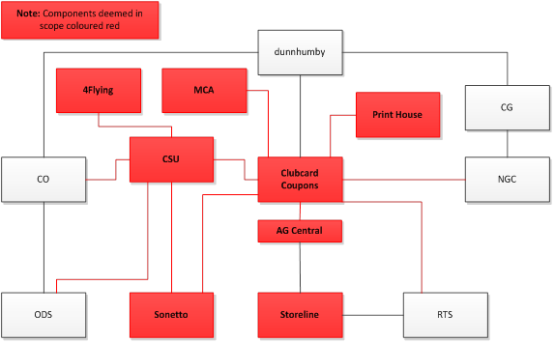
Integration with other system

Slide 17
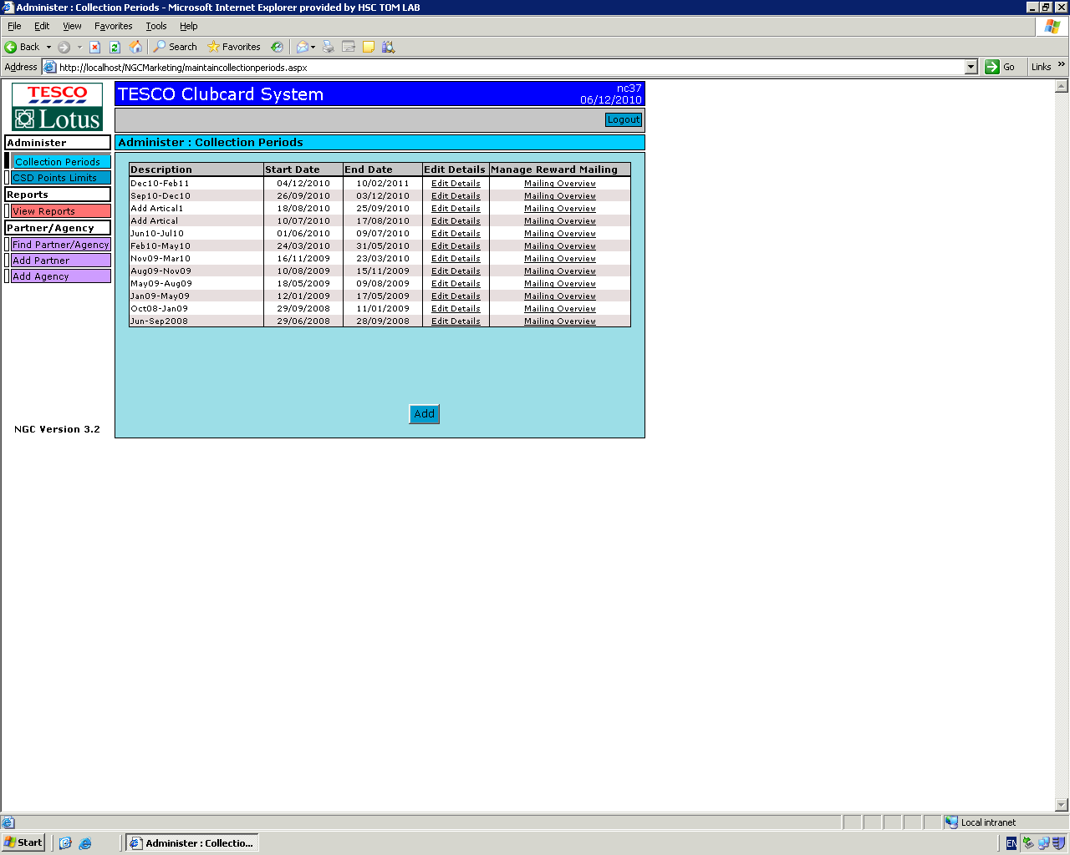
Application link and user details
Following image describes a typical screen in Marketing module
Current user Logged in
Screen Name
Use this button to Logout
Left Navigation Pane
Right Pane

Slide 18
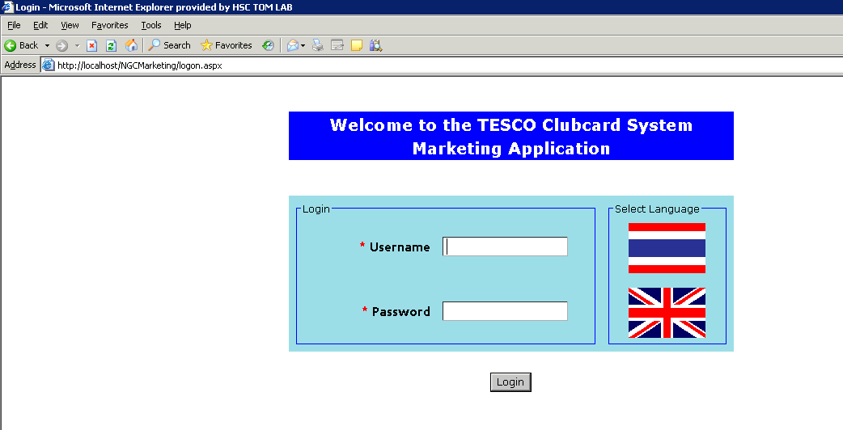
Login
Contd:
1. Type the URL given to you in the address bar of Internet Explorer
2. Select English or Local Language option using the Flags
3. Enter your Username and Password
4. Click “Login”
1
Language Flags
Type URL here
3
2
4

Slide 19

Appendix
Screen Description NGC screen details.doc
Hub Link:
https://tesco.sharepoint.com/teams/clubcardmarketingit/Pre2011_Programme/Forms/AllItems.aspx

Slide 20
Thank you. .

